Slide 1
Fuel Cell Progress
Code To Get Parameters
Parameters to Control
Fuel Cell Diagram
Simulink Model
SolidWorks Points
Objective
2.BUCK CONVERTER MODELLING AND CONTROL
Validation
NEW WAY

Slide 2
OBJECTIVE
Our Objective is to create a Simulink Model that simulates the operation of the entire system starting from the Photovoltaic Panels till we reach the motor (ie. Including the Electrolyser, Storage Tanks ,Fuel Cell, Motor and Battery).
The model will be automatically controlled and will cover the entire travel time from Alexandria to Aswan & Vice Versa.
In this presentation, we will demonstrate how we proceeded in the modeling and Control of the Fuel Cell.

Slide 3
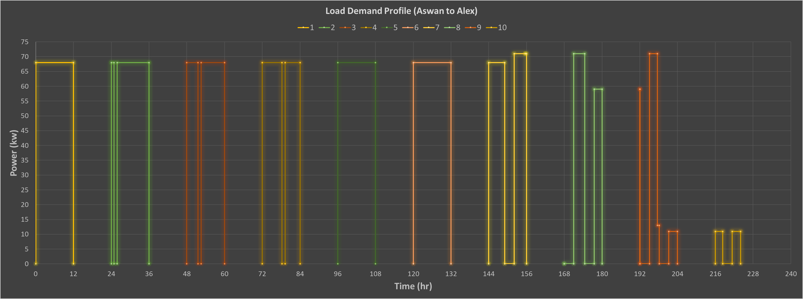
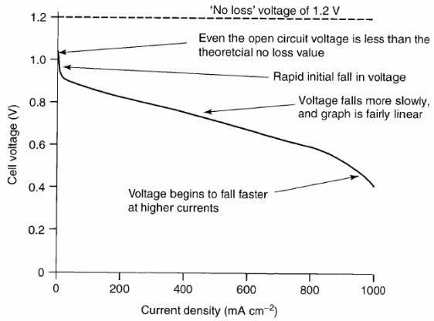
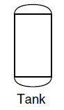


FUEL CELL DIAGRAM
FUEL CELL STACK
Volt (V)
Volt (V)
BUCK CONVERTER
Hydrogen Flow Rate
LOAD
Current (A)
I (A)
Air Flow Rate
Temperature (K)

Slide 4
Parameters to Control
1- Temperature → (Slow Response/small Range)
2-Partial Pressure →(it’s effect can almost be neglected)
3- Hydrogen Flow Rate ( Very Efficient)
4- Output Voltage (Inefficient if implemented solely ) can be done using either Buck Converter or Boost Converter or Both.
We Must Control Both Input and Output

Slide 5
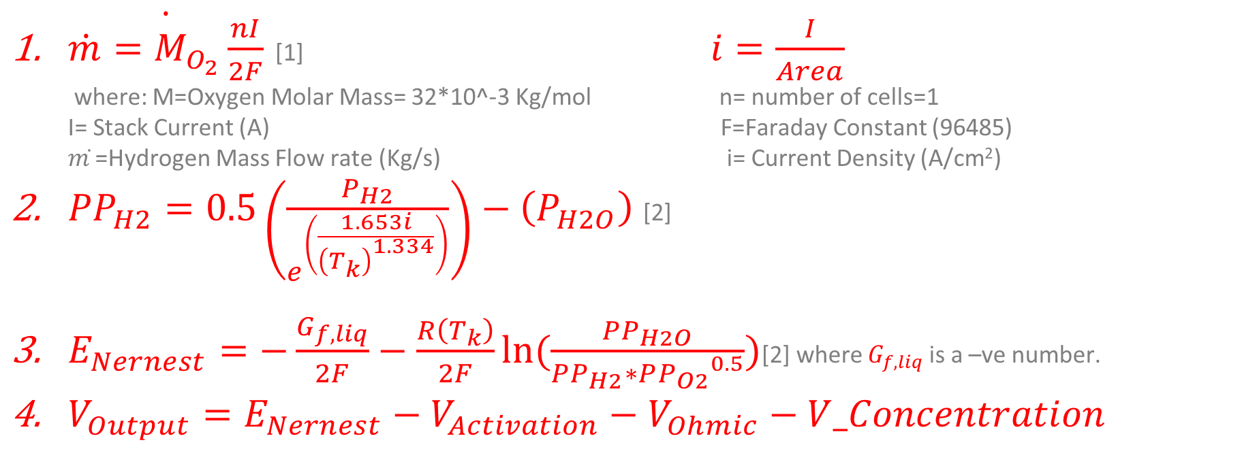
Simulink Model
Hydrogen Flow Rate & Voltage Equations
$\dot{\dot{m}=M_{O_{2}}\frac{nI}{2F}}$ [1] $i=\frac{I}{Area}$ where: M=Oxygen Molar Mass= 32*10^-3 Kg/mol n= number of cells=1 I= Stack Current (A) F=Faraday Constant (96485) 𝑚 ̇=Hydrogen Mass Flow rate (Kg/s) i= Current Density (A/cm²)
${PP}_{H2}=0.5\left(\frac{P_{H2}}{e^{\left(\frac{1.653i}{{\left(T_{k}\right)}^{1.334}}\right)}}\right)−\left(P_{H2O}\right)$[2]
$E_{Nernest}=−\frac{G_{f,liq}}{2F}−\frac{R\left(T_{k}\right)}{2F}ln⁡(\frac{PP_{H2O}}{PP_{H2}∗P{P_{O2}}^{0.5}})$[2] where $G_{f,liq}$ is a –ve number.
$V_{Output}=E_{Nernest}−V_{Activation}−V_{Ohmic}−V_Concentration$

Slide 6
IMPORTANT SIDENOTE
When we control the Hydrogen Flow rate , we are shifting the Fuel Cell operating point.
Therefore, we are limited to the Ohmic Region where the relation between the Current Density and the Output Voltage is fairly Linear.

Slide 7
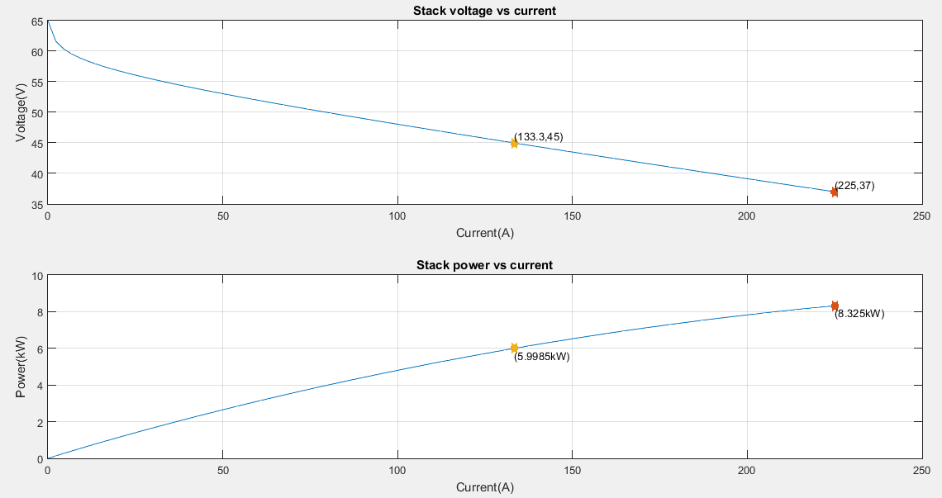
Simulink Model
Matlab Block
30

Slide 8
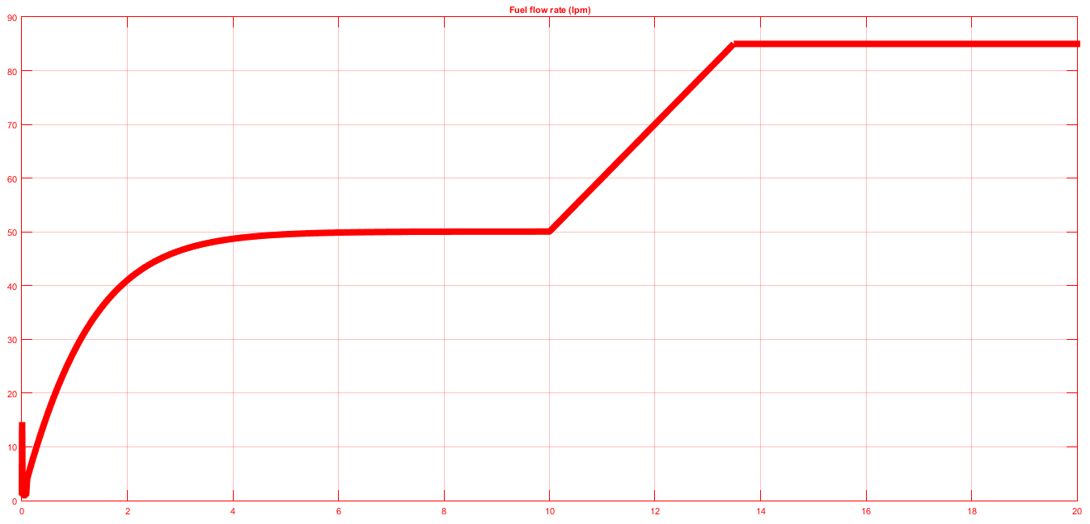
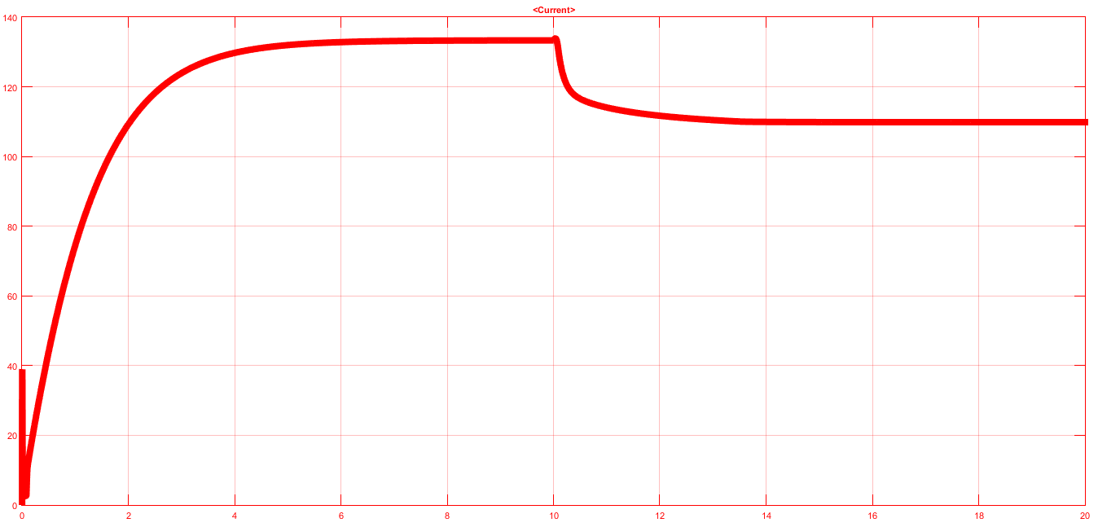
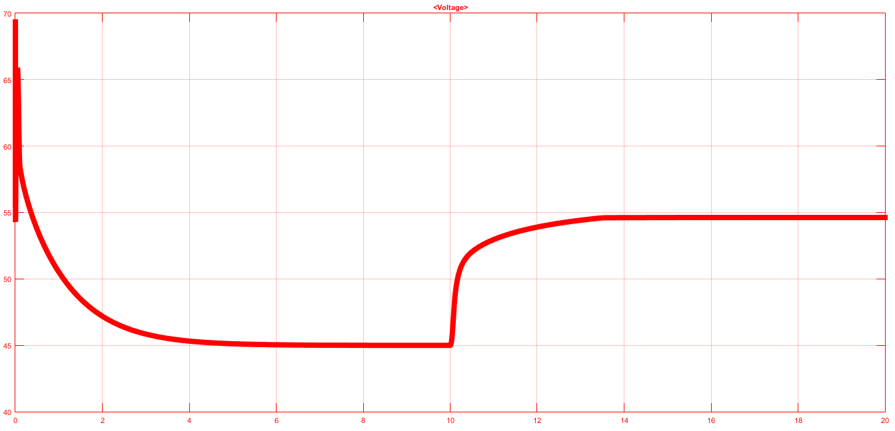
1-Fuel Cell Model/Matlab Model
Matlab Block

Slide 9
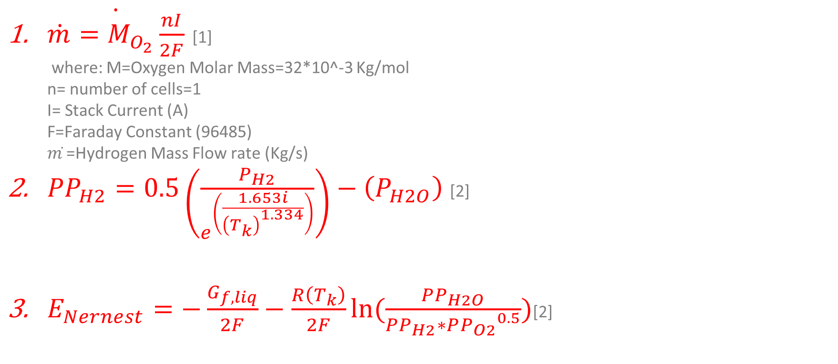
Simulink Model
Hydrogen Flow Rate & Voltage Equations
$\dot{\dot{m}=M_{O_{2}}\frac{nI}{2F}}$ [1] where: M=Oxygen Molar Mass=32*10^-3 Kg/mol n= number of cells=1 I= Stack Current (A) F=Faraday Constant (96485) 𝑚 ̇=Hydrogen Mass Flow rate (Kg/s)
${PP}_{H2}=0.5\left(\frac{P_{H2}}{e^{\left(\frac{1.653i}{{\left(T_{k}\right)}^{1.334}}\right)}}\right)−\left(P_{H2O}\right)$[2]
$E_{Nernest}=−\frac{G_{f,liq}}{2F}−\frac{R\left(T_{k}\right)}{2F}ln⁡(\frac{PP_{H2O}}{PP_{H2}∗P{P_{O2}}^{0.5}})$[2]

Slide 10
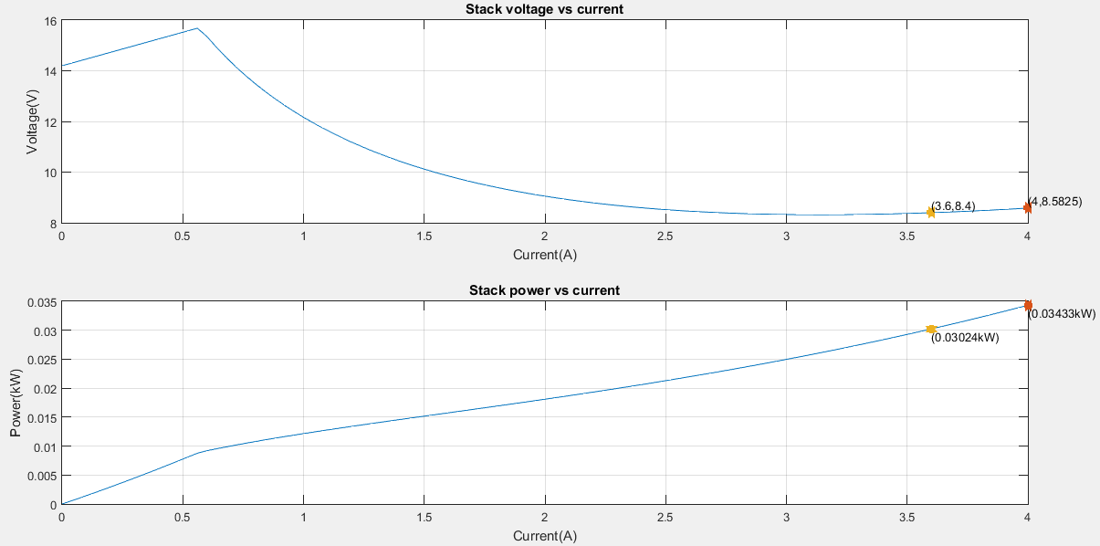
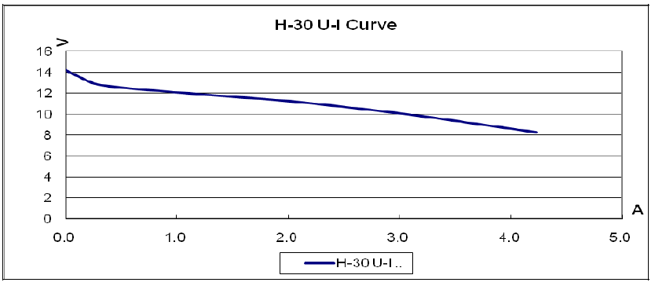
Simulink Model/Matlab Block (H-30 Curve)

Slide 11
Conclusion
The Included Fuel Cell Block in Matlab is erroneous Because: When the Flow Rate Increases , the Output Voltage Increases which is False.
This Block uses a certain set of Parameters depending on the type of the Fuel Cell and these parameters are fundamentally different from the common ones that are most often used in Fuel Cell Calculations.
Therefore, We have decided to create our own Model.

Slide 12
Model Assumptions
The model is dynamic ,ie, it models the fuel cell behavior with respect to time.
Fuel Cell Temperature is Constant.
No Excess Hydrogen ,ie, Every Hydrogen molecule that enters the fuel cell Stack reacts to produce electricity.
No excess Air.
Concentration Losses are not calculated in the Model as we will never approach this region during operation.

Slide 13
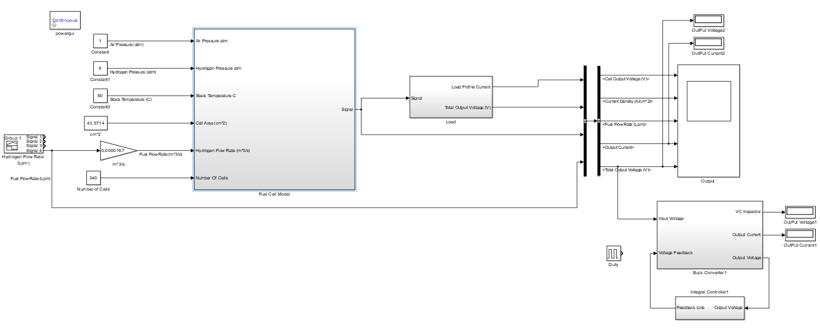
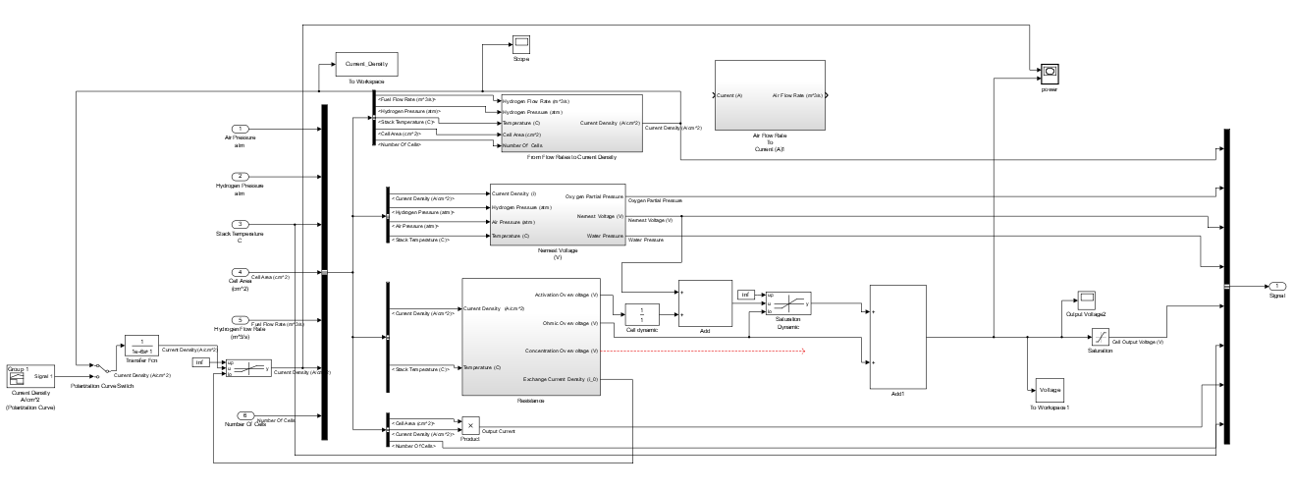
Simulink Model/Our Simulink Block

Slide 14
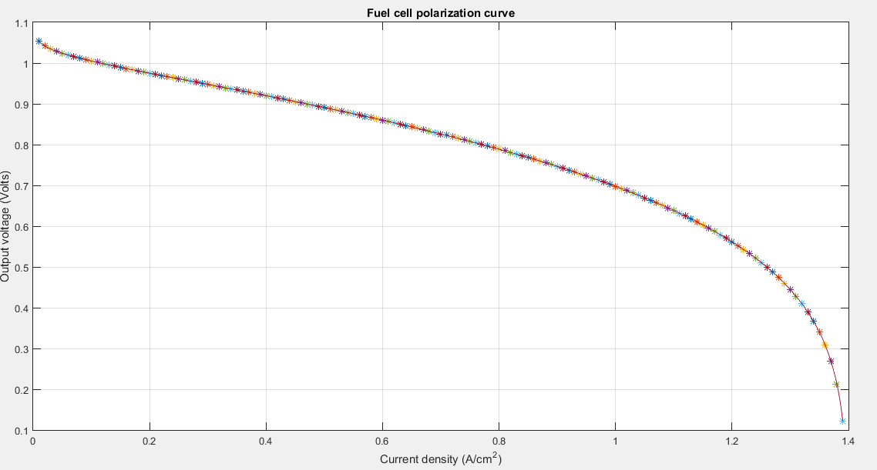
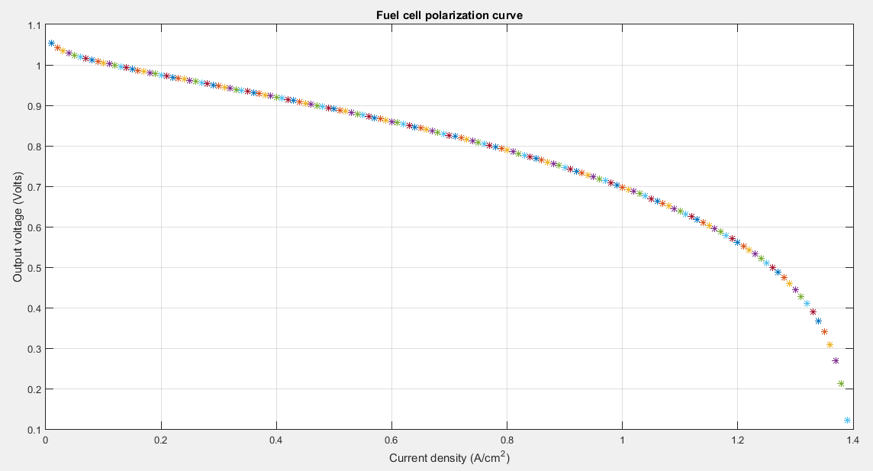
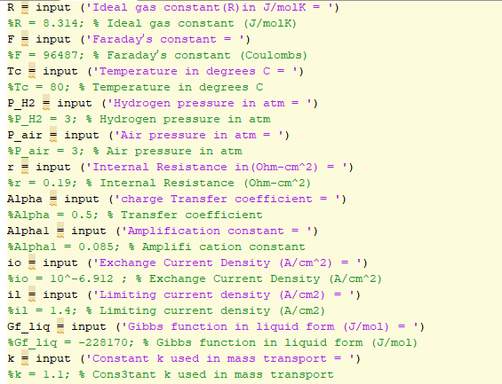
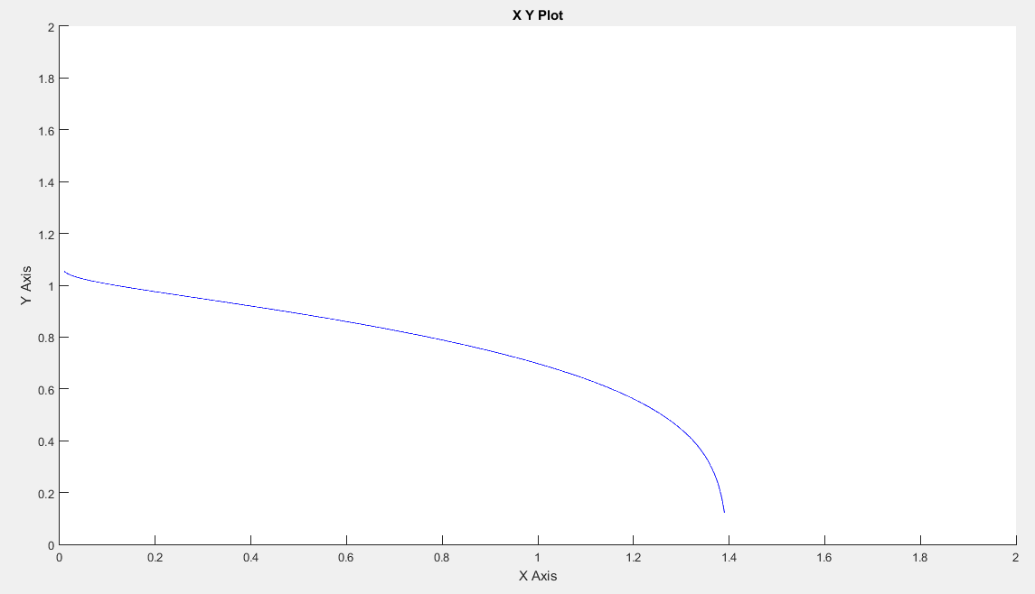
Simulink Model/Our Simulink Block (Validation)

Slide 15
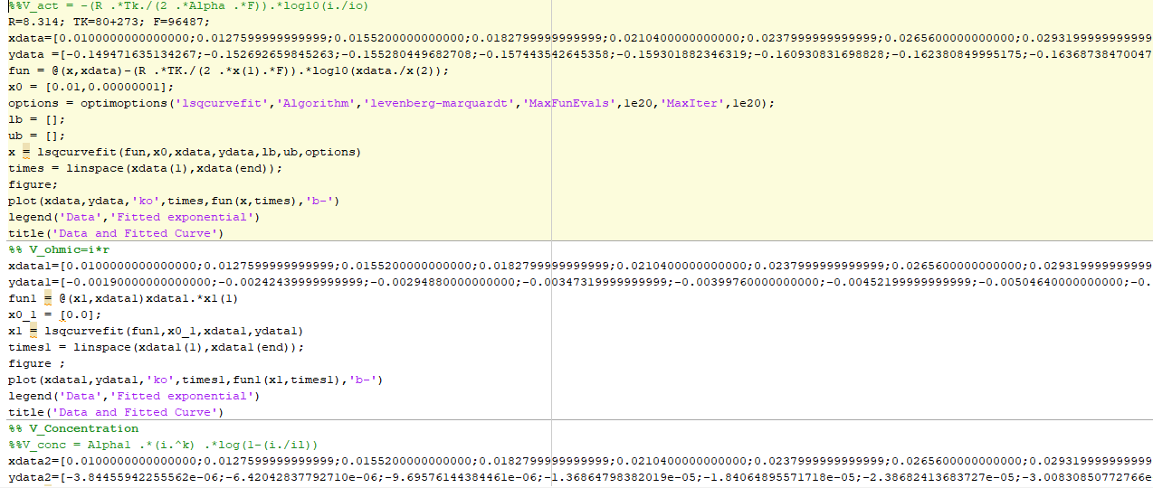
Code To Get Parameters/Non-Linear Regression

Slide 16
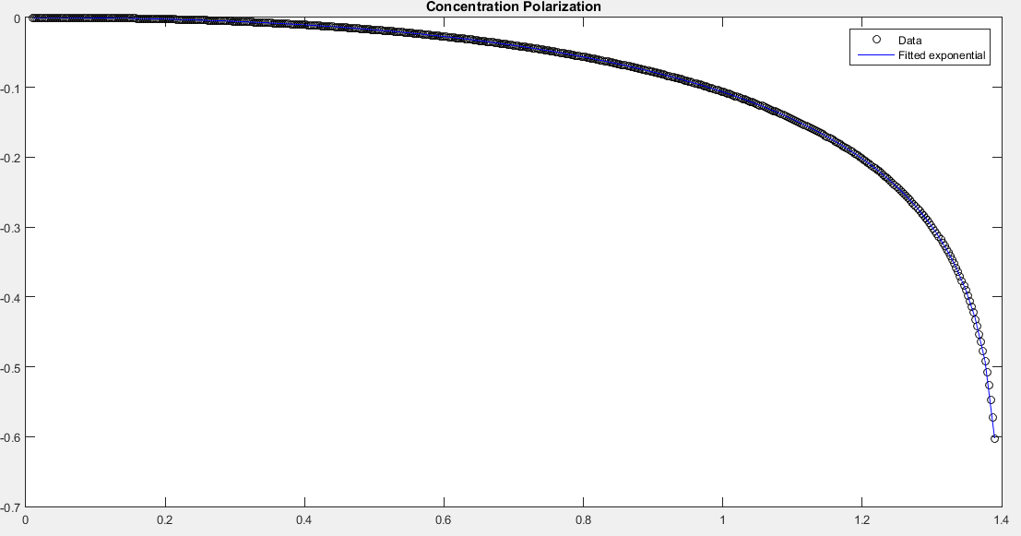
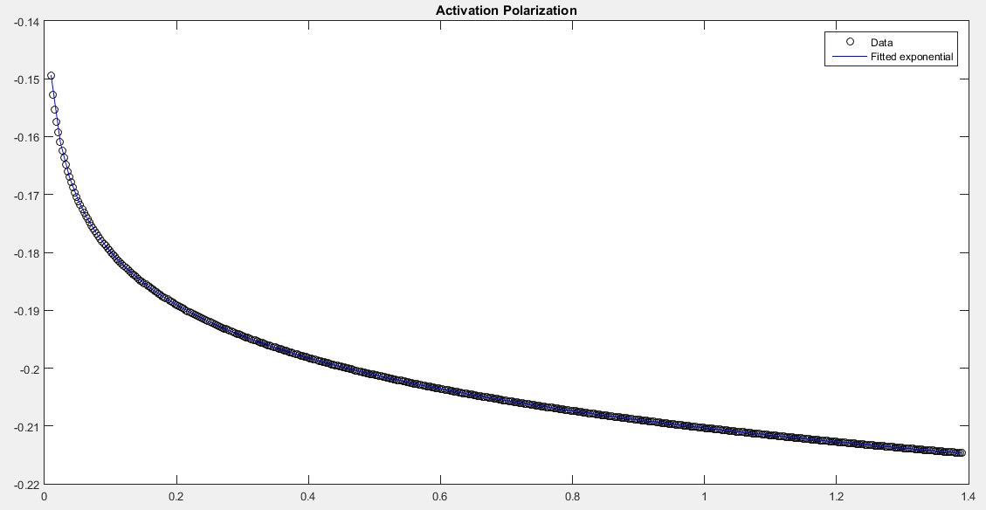
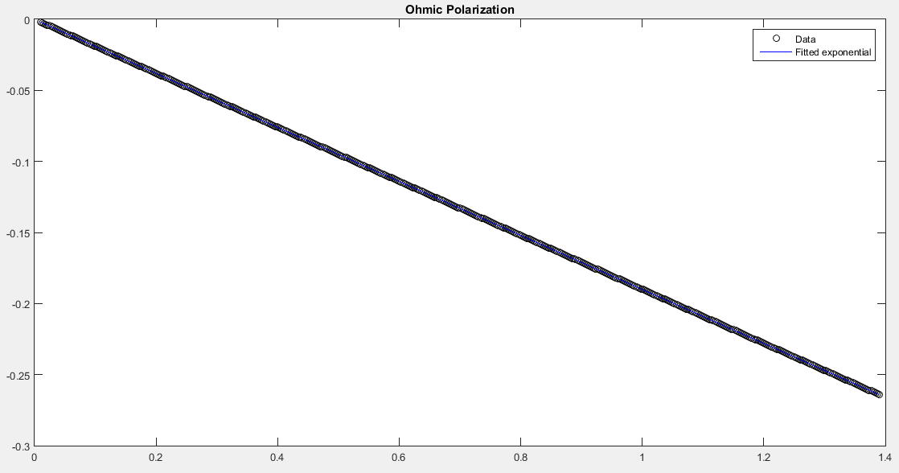
Code To Get Parameters
Our Experimental Curves

Slide 17
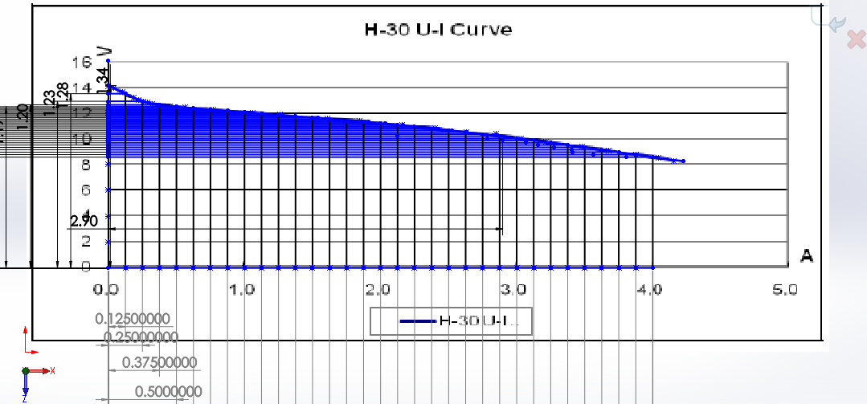
Code To Get Parameters
SolidWorks Curve to get the data points

Slide 18
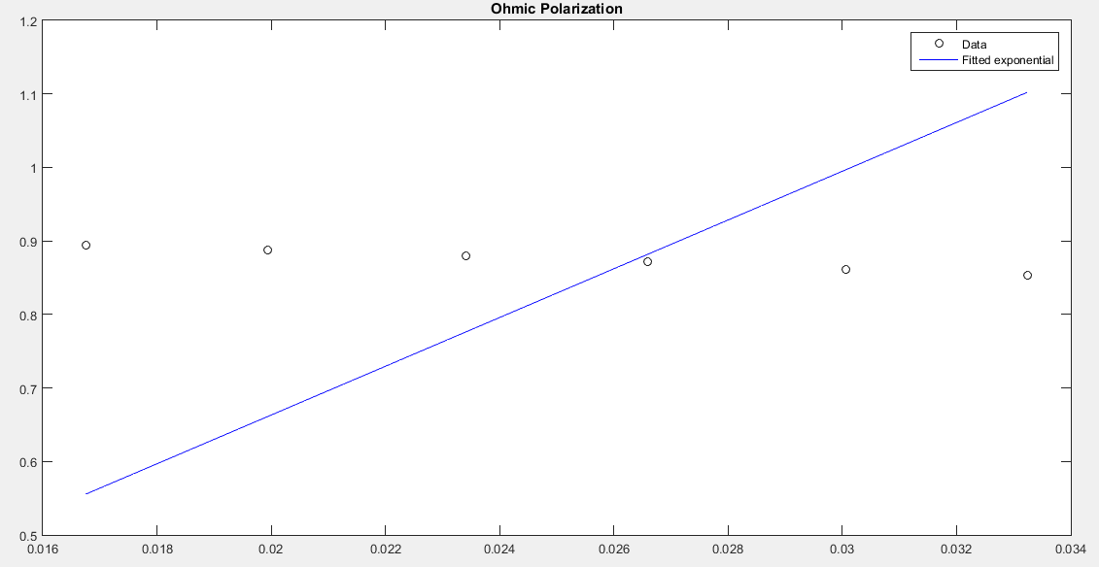
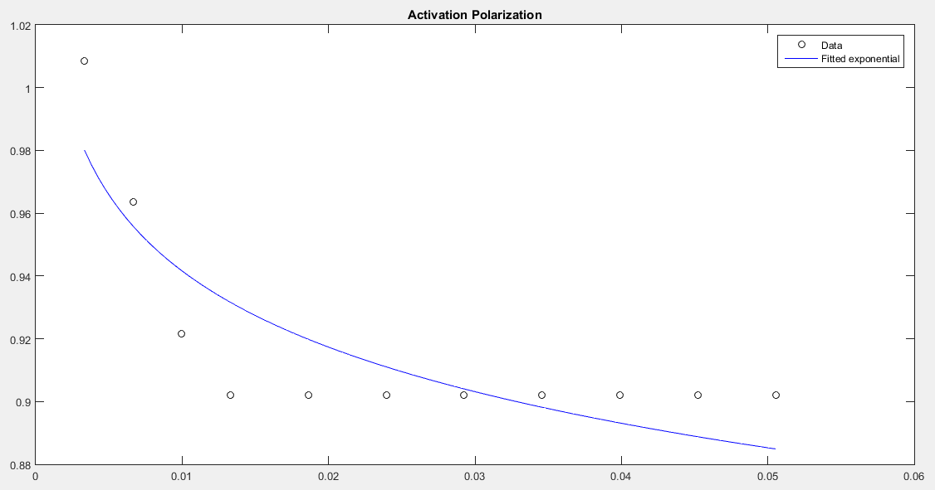
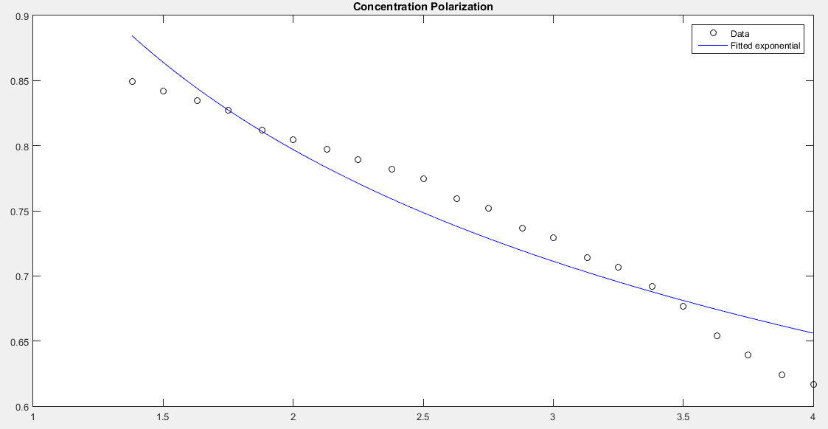

Code To Get Parameters
H-30 Wrong Curve

Slide 19
Code To Get Parameters
What Went Wrong ?
Our best guess is that for this code to work, the Initial conditions must be quite close to the actual values which is not possible when you have three unknowns in some cases.

Slide 20
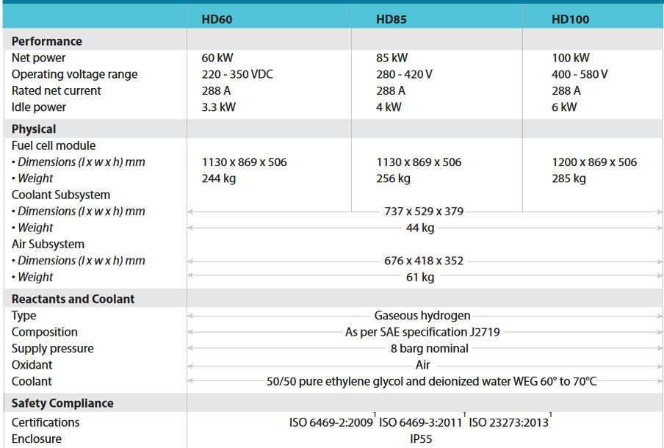
FULL SCALE FULL CELL MODEL
After Successfully modeling the Fuel cell example provided in [2]. We decided to model the Full Scale Ballard HD60 Fuel Cell.
As it was the only company that provided some technical details about their product.
Although Ballard did mention some details , they didn’t provide the Polarization Curve and thus the provided data was not enough to model the Fuel Cell Accurately. And so, we used the Trial And Error technique to get some fairly accurate results.

Slide 21
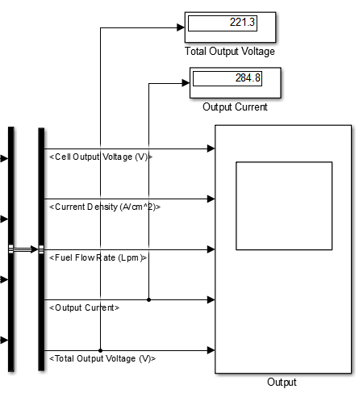
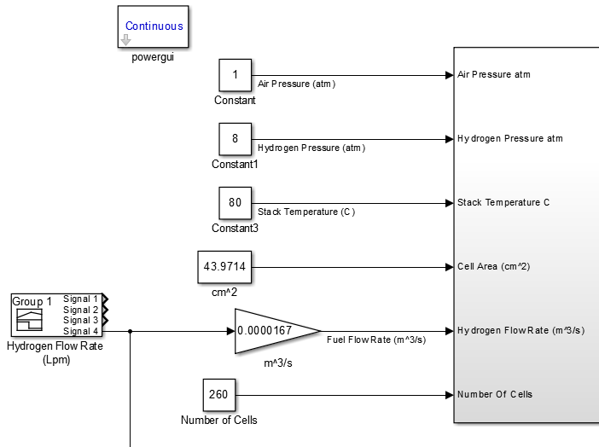
FULL SCALE FUEL CELL MODEL VALIDATION

Slide 22
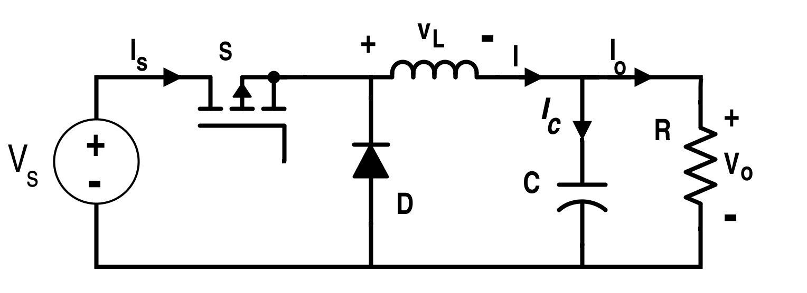
2.BUCK CONVERTER MODELLING AND CONTROL
Why We need that ?!
We need Buck Converter Just to control our output Voltage
Our Results said that Our Output Voltage will be always above we need in our circuit (220 Volt) So we need something to decrease it to 220 Volt
So we found that we should use Power Electronic device (Buck Converter) to decrease Voltage and increase the current.

Slide 23
WHAT’S NEXT ?
Our next Step is to model the Storage Tank and the pipe connecting it to the Fuel Cell and thus when the tank’s pressure change , a flow rate valve will be used to maintain a constant flow rate at all times.
This process will be done Automatically using the proper Control Circuit.

Slide 24
New Way
We think at the beginning that we should see change of partial pressure on System Output Voltage
But we researched it and after asking we found that
The Main Parameter which affects the Output Voltage is Hydrogen Flowrate
So We applied that on our model to see this change in our System.

Slide 25
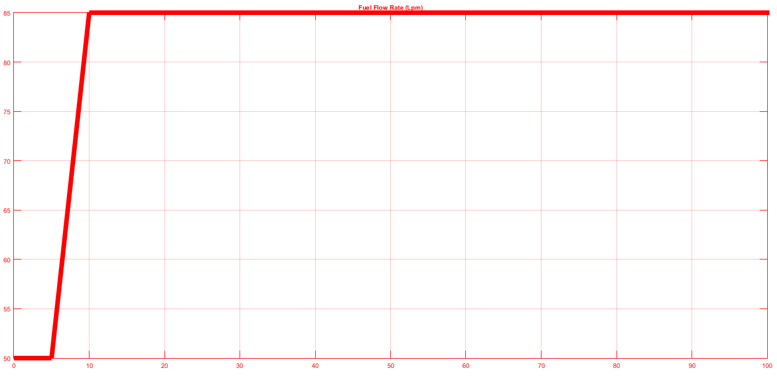
Hydrogen Flowrate

Slide 26
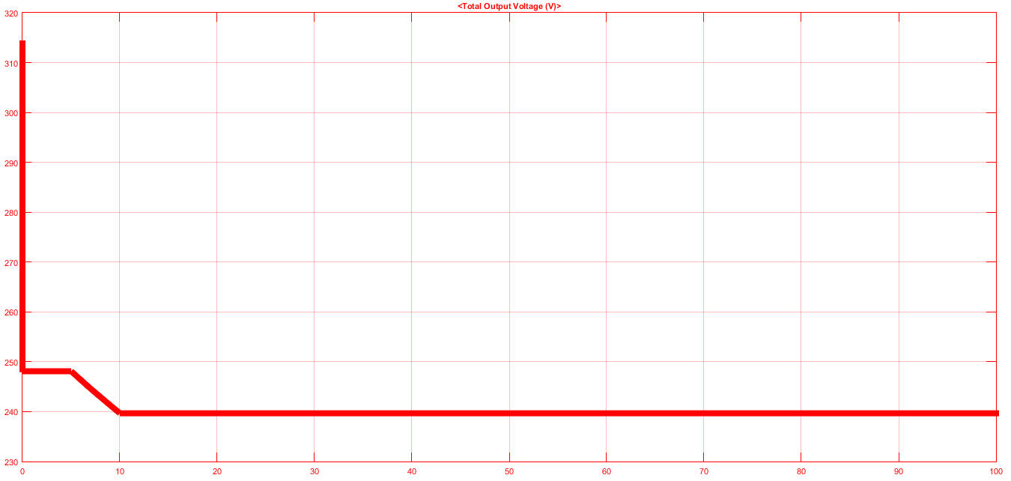
Hydrogen Flowrate

Slide 27
References
Modeling and Control of Fuel Cell Systems and Fuel Processors, Jay Tawee Pukrushpan
PEM Fuel Cell Modeling and Simulation Using MATLAB, Colleen Spiegel
Federico Zenith,Control of fuel cells,Doctoral thesis

